Slide 1


Slide 2
Box Model
Notes:
At the beginning of CSS lectures, you saw how CSS treats each HTML element as if it lives in its own box.
You can set several properties that affect the appearance of these boxes. In this lesson, you will see how to:
● Control the dimensions of your boxes
● Create borders around boxes
● Set margins and padding for boxes
● Show and hide boxes
By default a box is sized just big enough to hold its contents.

Slide 3
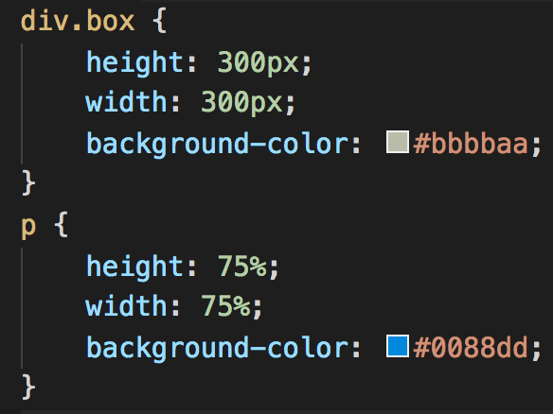
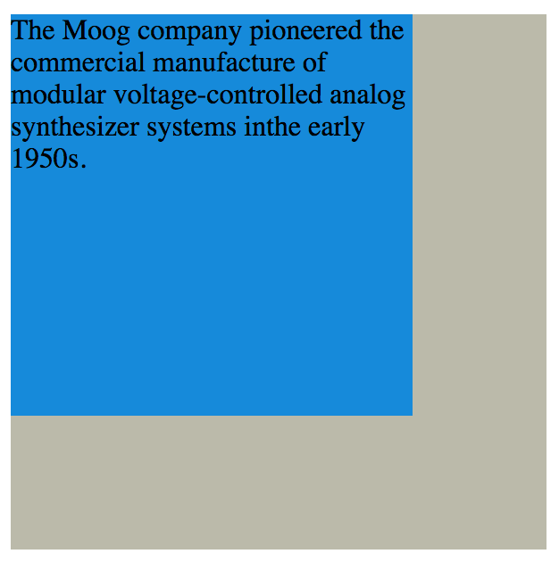
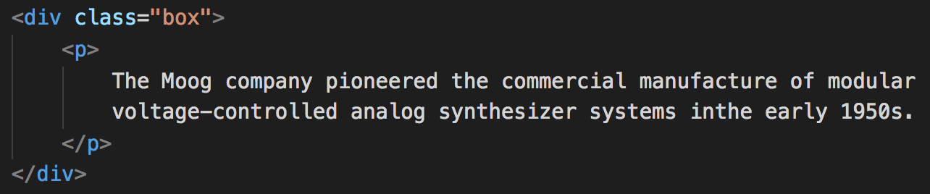
Box Dimensions
Use height and width properties to define box dimensions
Property value can be defined in:
px
percentage
ems

Slide 4
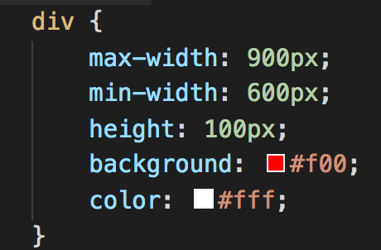
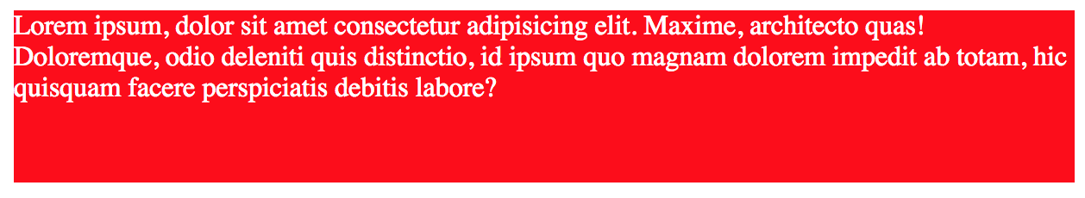
Limit Width
Need for restricting min or max width
Use min-width and max-width

Slide 5
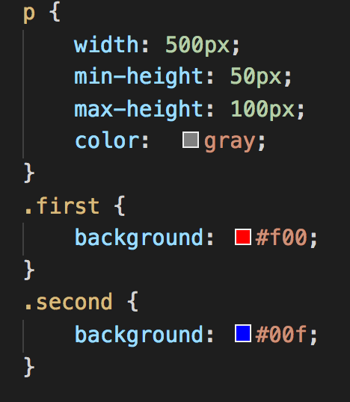
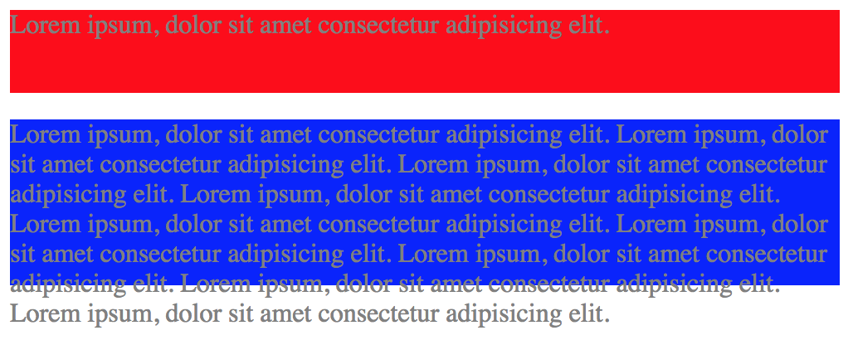
Limit Height
Similar to limiting width
Use min-height and max-height

Slide 6
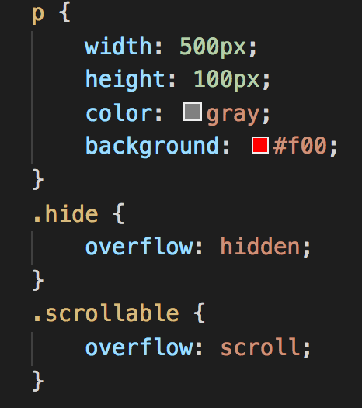
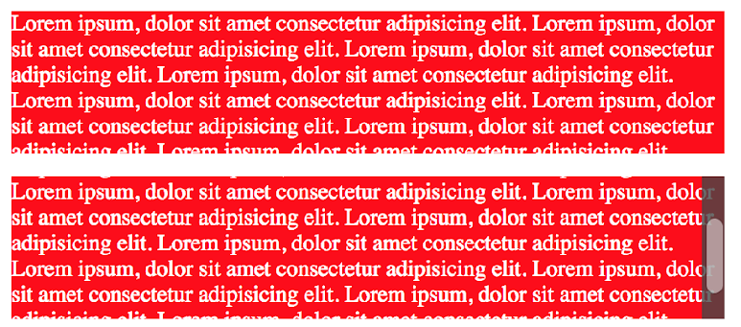
Overflowing Content
What to do when box content is larger then the box itself
Use overflow property to choose one of the two options:
hidden
scroll

Slide 7
Exercise

Slide 8
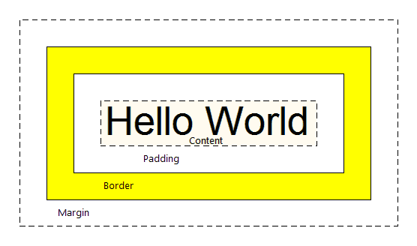
Border, Margin and Padding
Every box has three properties that control its appearance:
Border – edge of the box
Margin – outside of the border
Padding – between border and content

Slide 9
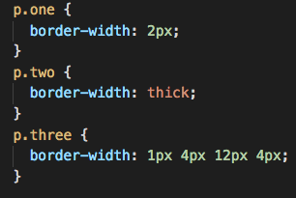
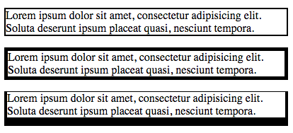
Border Width
Use border-width to define width of the border
Each border width can be defined separately
border-top-width
border-right-width
border-bottom-width
border-left-width
Property value can be:
thin
medium
thick
px
Define all borders with one property?

Slide 10
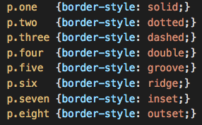
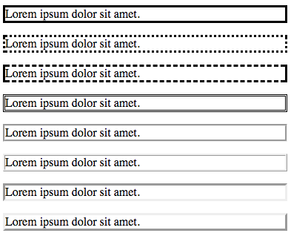
Border Style
To control border line style, use border-style
Values that this property supports are given in the example
Use hidden on none values to hide the border
Individually change the styles
border-top-style
border-left-style
border-right-style
border-bottom-style

Slide 11
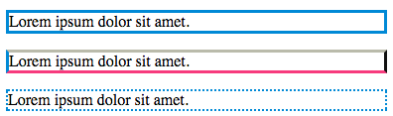
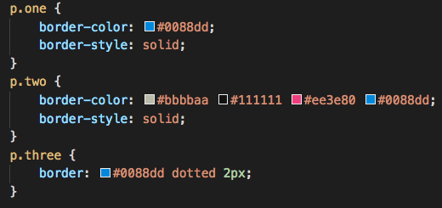
Border Color and Shorthand
Use border-color to define color
RGB values, HEX codes and CSS color names
Borders can be individually colored
Border width, style and color can be combined in one property (border)
The first value is width
The second value is style
The third value is color
border: 3px dotted #0088dd;

Slide 12
Exercise

Slide 13
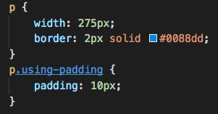
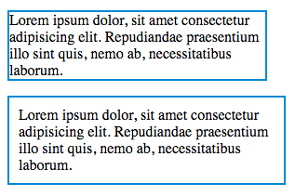
Padding
Space between element’s border and content
Name of the property is padding
Value can be defined in px, % or ems
Padding can be set for each side separately
padding-top • padding-right
padding-bottom • padding-left
Define padding using one line (clockwise)
padding: 10px 5px 3px 1px;
Padding will increase width/height of the box

Slide 14
Exercise

Slide 15
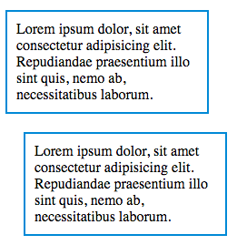
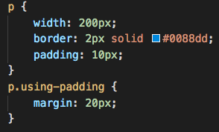
Margin
Use margin property to specify the gap between elements
Value can be defined in px, % or ems
Margin can be set for each side separately
margin-top
margin-right
margin-bottom
margin-left
Define margin using one line (clockwise)
margin: 10px 5px 10px 4px;

Slide 16
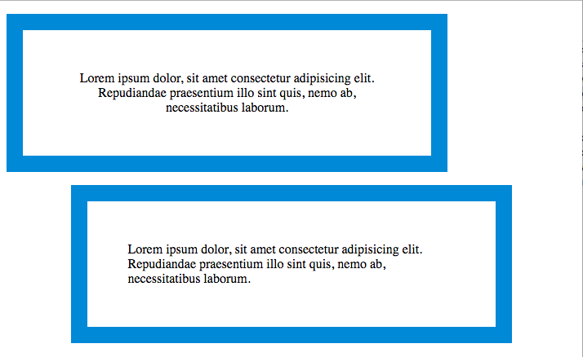
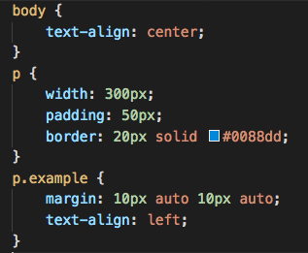
Box Centering
Use margin to center box on page or inside a parent element
The box needs to have width defined
Set margin-left and margin-right on auto

Slide 17
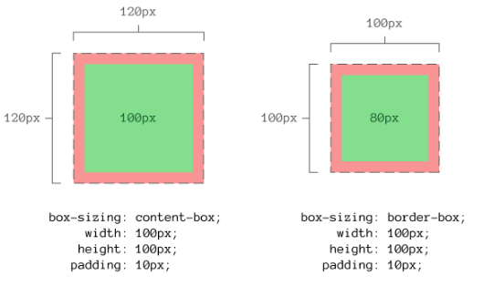
Box Sizing
When width is defined, it becomes width of the box content
When padding or margin is set, it increases the overall width of the box
box-sizing allows us to define what is covered by width
Values that box-sizing expects are:
content-box
border-box

Slide 18
Exercise

Slide 19
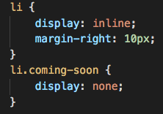

Inline/Block Change
Switch from inline to block element and vice versa
The display property is used for this purpose
Allowed values:
inline
block
inline-block
none

Slide 20
Exercise

Slide 21
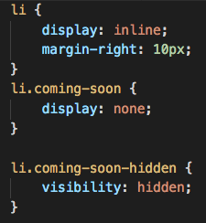

Hiding Boxes
The visibility property allows showing/hiding boxes
Property can have one of the two values:
hidden
visible
display VS visibility
If the visibility of an element is set to hidden,
a blank space will appear in its place. On the
other hand, using the display property leaves
no trace of the element on the page.

Slide 22
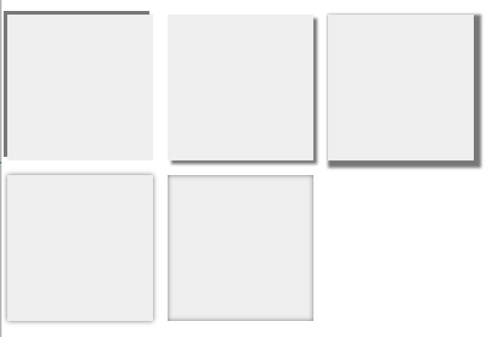
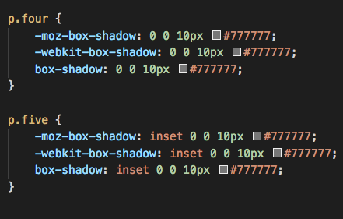
Box Shadows (CSS3)
Use box-shadow property to add a shadow around the box
Similarly to the text shadow, this prop requires
multiple values
Horizontal offset
Vertical offset
Blur distance
Spread radius
Save time and use online generator
https://www.cssmatic.com/box-shadow

Slide 23
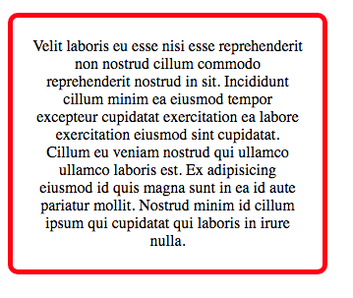
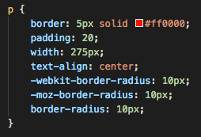
Rounded Corners (CSS3)
Use border-radius property to round corners
Round corner by setting the diameter for value
border-radius: 10px;
Each corner can be rounded separately
border-radius: 10px 15px 5px 8px;

Slide 24
Exercise

Slide 25
Summary
CSS treats each HTML element as if it has its own box.
You can use CSS to control the dimensions of a box.
You can also control the borders, margin and padding for each box with CSS.
It is possible to hide elements using the display and visibility properties.
Block-level boxes can be made into inline boxes, and inline boxes into block-level boxes.
CSS3 has introduced the ability to set rounded borders.

Slide 26
References
Box Model - https://goo.gl/vjx4B8
Box Shadow - https://goo.gl/VMtypn
Box Sizing - https://goo.gl/fWkjsV

